Slide 1

Climate initiatives
A current market analysis

Slide 2

agenda
Growth strategy
Market analysis
Financial overview
Innovative solutions
Future initiatives

Slide 3

Strategies for growth
New collaborative approaches for market success

Slide 4

current market analysis
We have identified important key trends that demand our attention.
Data reveals a steady increase in consumer demand for sustainable products, presenting an opportunity for our eco-friendly offerings.
Our competitors are now focusing on digital marketing strategies, suggesting a shift in consumer behavior.
Understanding these nuanced dynamics positions us to adapt and capitalize on emerging market preferences.

Slide 5

Market expansion
Unlocking new horizons

Slide 6

product launch
Q3
Market research
Q4
Product development
Q1
User testing
Q2
Product launch
Currently gearing up for a ground-breaking launch
Our new offerings will captivate the market
Our marketing campaign will generate anticipation

Slide 7

marketing strategies
Implement personalized engagement strategies
Tailor campaigns to resonate with specific demographics, fostering a sense of relevance and connection
Collaborate with influencers and thought leaders to amplify our brand message

Slide 8

financial overview
Our financial overview reflects a robust and resilient fiscal performance.
Key indicators show consistent revenue growth over the past quarter, attributed to strategic cost management and successful marketing.
Operating margins have improved, signaling operational efficiency, while strengthening our reserves.
This underscores our commitment to financial stability, positioning us for sustained growth.

Slide 9

course progress
Market expansion
Product innovation
Customer retention
Operational efficiency
Quarter | Revenue growth (%) | Market share increase (%) | Customer acquisition
Q1 | 12 | 2 | 500
Q2 | 15 | 3 | 600
Q3 | 18 | 4 | 700
Q4 | 20 | 5 | 800

Slide 10

course progress
Metric | Current value | Previous quarter | Change (%)
Revenue | $2,500,000 | $2,200,000 | +14%
Operating expenses | $1,200,000 | $1,400,000 | -14%
Net profit | $1,000,000 | $800,000 | +25%
Operating margin | 40% | 36% | +4%
Cash reserves | $5,000,000 | $4,500,000 | +11%

Slide 11

Innovative solutions

Slide 12

future initiatives
Product enhancement. Introduce regular updates and features to enhance product offerings.
Technology integration. Explore emerging technologies for potential integration into our operations.
Collaborative partnerships. Foster collaborations with tech innovators and industry leaders to drive innovation.
Green supply chain
Reduced carbon footprint
Waste reduction
Water conservation

Slide 13
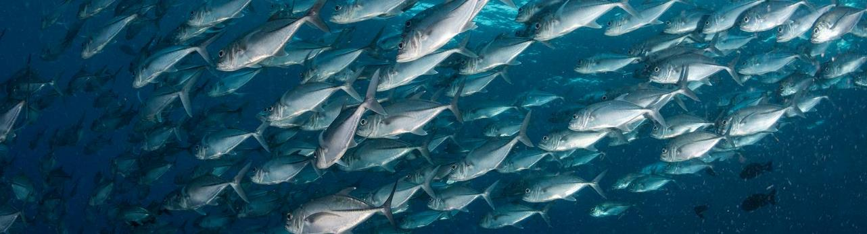
contact info
Remy Morris
206-555-0146
rmorris@contoso.com
www.contoso.com

